Slide 1
CMP202 Assessment
By Fraser Barker(1600196)

Slide 2
Topic
Interactive Mandelbrot
Parallelised using GPU
Lab exercise used as a basis
External Libraries
OpenGL (Year 2, Semester 1 base project file)

Slide 3
Purpose
Purpose of the application and the problem you’re trying to solve through parallel programming
Interactive Mandelbrot via OpenGL
Run quicker/demonstrate good GPU parallelisable algorithm.

Slide 4
Parallel construction
How the parallel parts of the code are structured(e.g. in terms of patterns discussed in the module) and how they are integrated with the rest of your application.
SIMD
Parallel for each?

Slide 5
Thread utilisation
How your application makes use of threads and how interactions between threads are managed safely (mutexes, atomic operations or barriers).
Single CPU Thread
Parallel for each?
Non-tiled GPU utilised function
No communication between pixels so no interactions therefore no mutexes, atomic operations or barriers

Slide 6
Specification
The CPU or GPU specification used for testing depending on your chosen application.
4506 Lab Computers
OS – Windows 7 Professional
GPU – Intel® HD Graphics 2500
CPU – Intel® Core™ i5-3470S @ 2.90GHz
RAM – 4GB

Slide 7
Results
Time taken to compute Mandelbrot at various levels. (Iterations, Width/Height) (ms)
1000 x 500,2500,5000 Max_Iters @ 640x480
1000 x 500,2500,5000 Max_Iters @ 1280x720

Slide 8
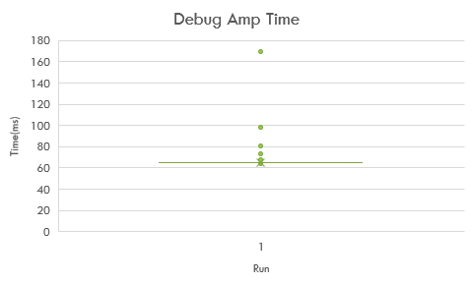
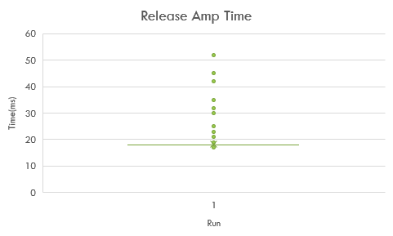
Results
1000 x 500 Max_Iters @ 640x480

Slide 9
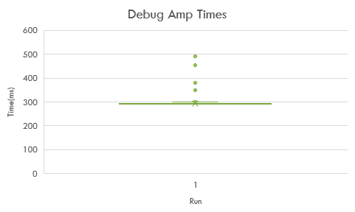
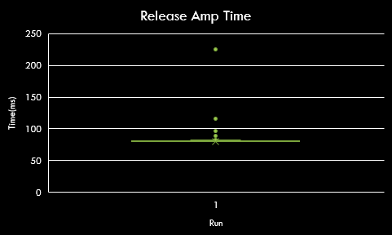
Results
1000 x 2500 Max_Iters @ 640x480

Slide 10
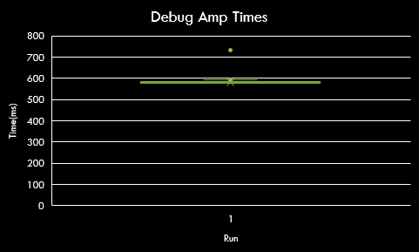

Results
1000 x 5000 Max_Iters @ 640x480

Slide 11
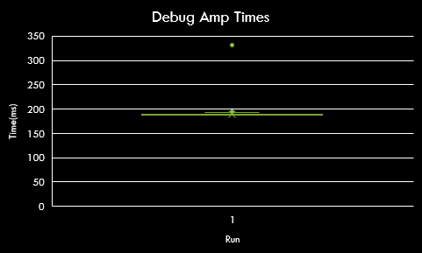

Results
1000 x 500 Max_Iters @ 1280x720

Slide 12

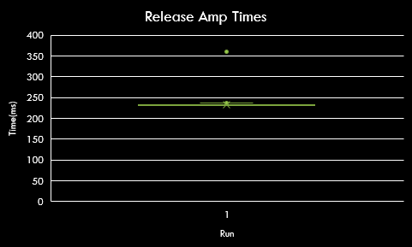
Results
1000 x 2500 Max_Iters @ 1280x720

Slide 13
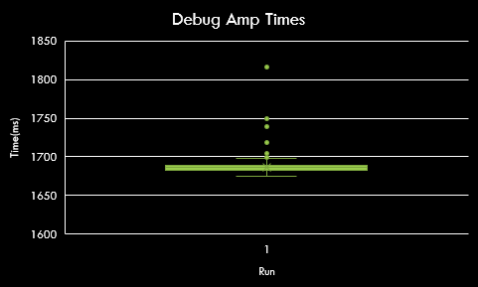

Results
1000 x 5000 Max_Iters @ 1280x720

Slide 14
Results
1000 x 500 Max_Iters @ 640x480 vs 1280x720

Slide 15

Results
1000 x 2500 Max_Iters @ 640x480 vs 1280x720

Slide 16
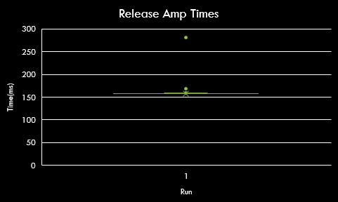
Results
1000 x 5000 Max_Iters @ 640x480 vs 1280x720

Slide 17
Explanation
An explanation of these results in terms of the design of your application and your understanding of processor and memory architecture (i.e a description of why it performs the way it does) on the CPU or GPU.

Slide 18
Key results
Presentation of key results of the performance evaluation (Slides 3 – 5)
Timing against various renderings of Mandelbrot.

Slide 19
Critical evaluation
A critical evaluation of the effectiveness of your solution, with reference to your performance evaluation.

Slide 20
Technical choices
You must explicitly justify your technical choices, and quantify their effect during performance evaluation, using the knowledge you’ve gained from undertaking the module.

Slide 21
Resources
SciPy – Statistics calculations, graphical representations.
Adam Sampson/Ruth Falconer – Lab project which this submission is based off of.
Paul Robertson – OpenGL base project

